Slide 1


KGISL INSTITUTE OF TECHNOLOGY
PY-EXPO - 2021
Team Members:
Pavithra
Sindhu
Salman

Slide 2

Overview
1. Problem Identification
3. Packages Used and Alternatives
2. Objectives
6. Sample source code
4. Advantages
5. Workflow
7. Inputs and Outputs in program
8. Errors Occurred
9. Applications

Slide 3

Problem Identification
In our day to day life, we all have lot of works in our mind which easily forgets the to-do-list and it’s not possible to write email before every event to remind the user. So why don’t we automate emails to remind the user before an event. This program helps us automate email every time before an event starts.

Slide 4

Proposed System
Develop Reminder Email Sender with Python
Objective
Develop a program that sends automated emails with respect to time using python.

Slide 5

Used Packages
Some of the Packages we used to grab the audience’s attention right from the start: unexpected, emotional, or simple.
Streamlit Streamlit used for frontend (appearance and design).
Smtplib Smtplib used for sending email to receiver.
Datetime and Time Datetime and Time pkg used for identifying date and time to send reminder.

Slide 6

Alternative Packages
Some of the Alternative Packages we can use for this project
Dash Dash is also an open source package that is used to build interactive webpages and can be used as alternative for streamlit.
Quick-mailer Qick-mailer helps to send email faster and can be used as an alternative for smtplib. This Module only Supports Gmail & Microsoft Accounts (hotmail, outlook etc..)
Pendulum The pendulum is one of the popular python DateTime libraries. It provides a cleaner and easier API to use.

Slide 7

Advantages of sending reminder emails
Saves time
Don’t want to write email manually every time.
We can use it as a private reminder to remind us do certain tasks.

Slide 8
1
2
3
Install and Import Streamlit, smtplib and ssl pkg
Import Datetime and Time
Build frontend with streamlit
Workflow
6
5
4
reminder functionality by Datetime and Time
Add Button functionality to send email
Build Email functionality with smtplib and ssl
7
8
Initialize email Sender
Run Streamlit app

Slide 9

Sample Code
Some of the sample code that is used in this project
context = ssl.create_default_context()
with smtplib.SMTP(smtp_server, port) as email:
email.starttls(context = context)
email.login(bot_email, password)
send_time = dt.datetime(2022, 1, 5, 14, 43, 00)
x = time.sleep(send_time.timestamp() - time.time())
email.sendmail(bot_email, reciever_email, message)

Slide 10
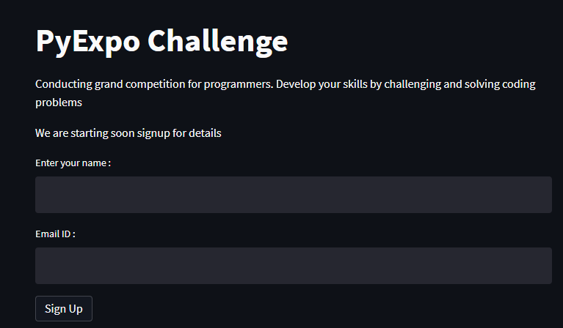
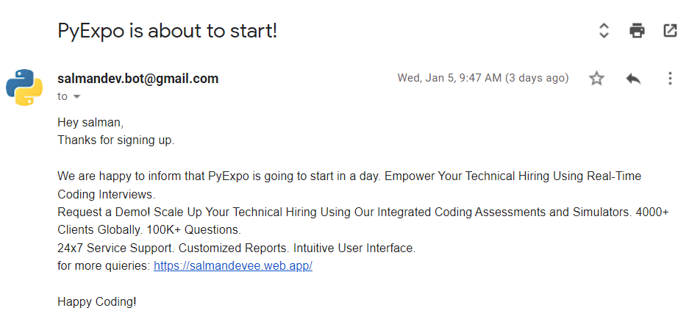
Inputs
Output
Inputs we want to run this program. Inputs like the receiver email and receiver name are stored and be used.
Output achieved by this program. This picture shows the sample output that we got from this program

Slide 11
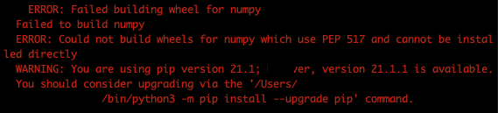
Errors Occurred :
Errors Rectified by
Errors occurred while installing Streamlit package.
ERROR: Failed building wheel for numpy
Installing Conda Environment
Run Streamlit in Conda Environment
Errors had been rectified by installing virtual environment like anaconda in the local machine and streamlit package inside the conda environment
Tried Cases :
~$ pip install –upgrade pip
~$ pip install pyarrow
~$ pip –upgrade streamlit

Slide 12

Applications
It is being used in local companies as well as in big ecommerce giants like Amazon, Flipkart etc
It is used to remind deadlines or event start date to users.
It is more useful in marketing systems like affiliate marketing and email marketing
It is being used in online classes to remind students to join classes

Slide 13
Thank You
By : Pavithra, Sindhu and Salman

